Slide 1
Unit 4
Lecture 6

Slide 2

Morphological Algorithms
1. Hole filling or Region filling
Hole: Hollow region within the boundary

Slide 3
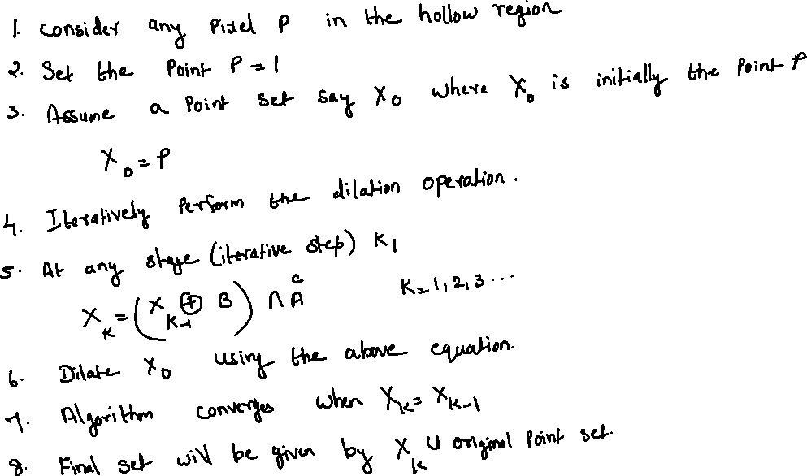
Algorithm:

Slide 4
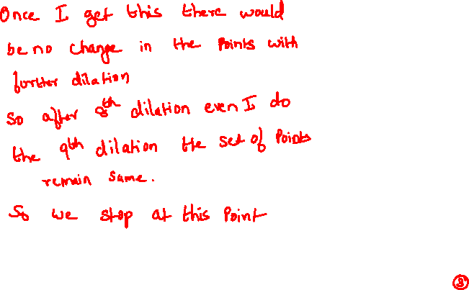
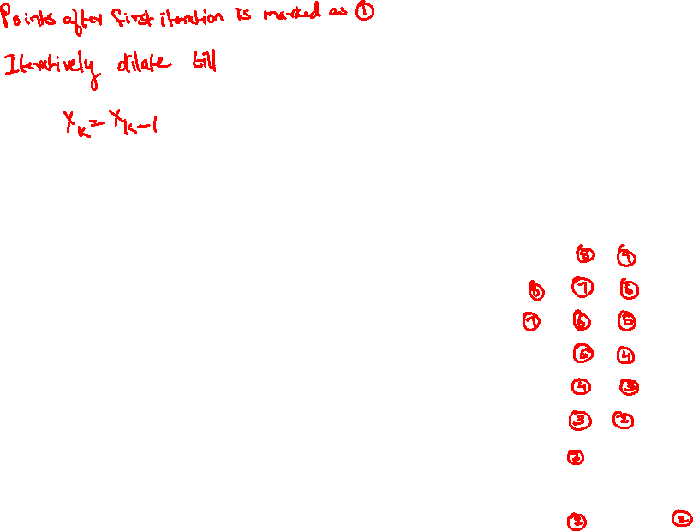
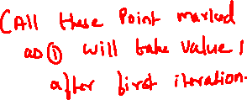
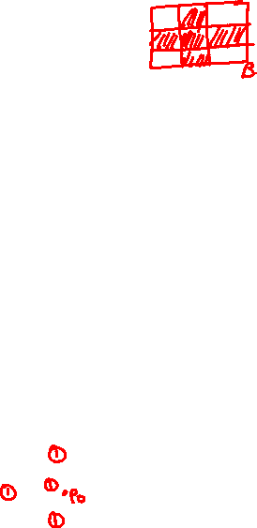


Slide 5
 |  |  | 1 | 1 | 1
 |  | 1 | 0 | 0 | 1
 | 1 | 0 | 0 | 0 | 1
 |  | 0 | 0 | 0 | 1
 |  | 1 | 0 | 4th | 1
 |  | 1 | 4th | 3rd | 1
 |  | 1 | 3rd | 2nd | 1
 |  | 1 | 2nd | 1st | 1
 |  | 1 | 1st | 0 | 1 | 1
 | 1 | 3rd | 2nd | 1st | 2nd | 1
 | 1 | 1 | 1 | 1 | 1 | 1

Slide 6
The dilation operation will fill the entire area if left unchecked
This is restricted within the object boundary when you take the intersection
All the points within the object boundary is now made to 1
Very useful method for object recognition.

Slide 8
2. Connected Component Extraction
Algorithm:
We have a point set A
Y is a connected component in A
Extract all the points which belong to Y
We are trying to extract the subset of A which are connected to A
Algorithm will converge when Xk= Xk-1

Slide 9
 |  |  |  | p

Slide 10
 |  |  | 1st | p | 1st
 |  |  |  | 1st
 |  |  | 1st

Slide 11
 |  |  |  |  |  |  | 5th | 6th | 7th
 |  |  |  |  |  | 4th |  |  | 7th
 |  |  |  |  |  | 3rd |  |  | 6th
 |  |  |  |  |  | 2nd | 3rd | 4th | 5th
 |  |  | 1st | p | 1st | 2nd
 |  | 2nd |  | 1st
 |  |  | 1st
8th iteration is the same as 7th so we stop.
These are the points in Y

